Slide 1


Business Challenge
INTEGRATED PLANNING CASE

Slide 2
TABLE OF CONTENTS
01
02
03
04
PROJECT
INTRODUCTION
PROBLEMS
& SOLUTIONS
Case study and project phases
Marketing, automation and feedbacks
KPIs & GREEN
APPROACH
CONCLUSIONS
& CONSIDERATIONS
Key metrics and a look to the environment impact
Recap and customer’s feedback

Slide 3
01
PROJECT
INTRODUCTION
Case study and project phases

Slide 4


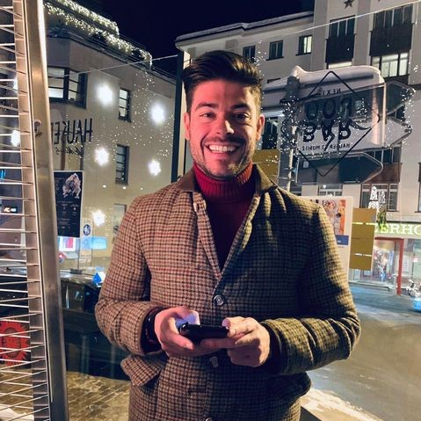
CASE STUDY
“Our goal is to make healthcare
services at home accessible to everyone”
Andrea Timolina - CEO

Slide 5
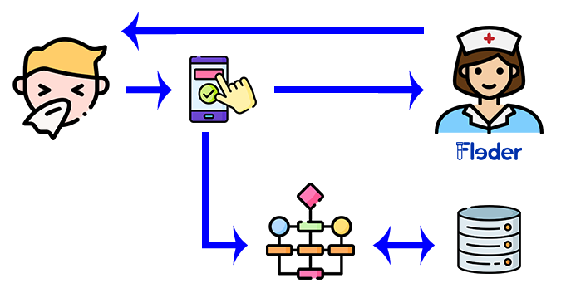
MODUS OPERANDI

Slide 6





PROJECT PHASES
REVISION
Team meet to review the report together
MEETINGS
Collaboration with Fleder’s CEO
CONCLUSION
Final preparations and presentation
SETUP
Choice of roles, group name and project topic
DEVELOPMENT
Individual work

Slide 7
02
PROBLEMS
& SOLUTIONS
Marketing, automation
and feedbacks

Slide 8




UNDERSTANDING THE PROBLEMS
Marketing
problem
Lack of automatic management of corporate resources
Collecting feedback
Lack of medical staff willing to collaborate with the team
(supply shortage)
Management of medical staff’s schedules and people's request
Only a small amount of users leave a feedback
of the app

Slide 9
2.1
Marketing PROBLEM
Demand and Supply marketing campaigns

Slide 10
MARKET ANALYSIS
51%
49%
1
PRIVATE
2
PUBLIC

Slide 11
LOCATION CHARACTERISTICS
Italian Population by age
3. 63,8%
2. 23,2%
1. 13%
1
2
Above 65
3
0-14
15-64

Slide 12





COMPETITORS

Slide 13



FLEDER’S VALUE PROPOSITION
Accessible to all the ages
Fast to book
by the app
Services at
low cost

Slide 14
2.2
Marketing
PLAN FOR THE DEMAND
Campaign’s description

Slide 15




SEGMENTATION & POSITIONING
Demographics
Psychographics
Above 60 years old
Hypochondriacs people
Lifestyle traits
Behavior
Busy and lazy people

Slide 16
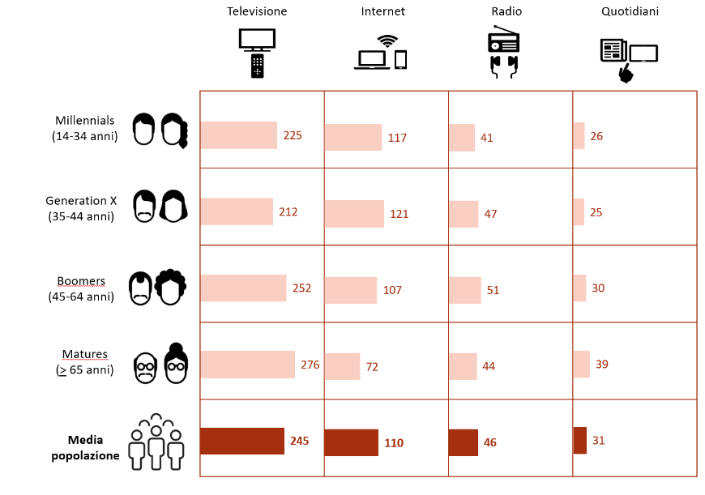
PROMOTION
Content & Location
To make emphasis in Fleder’s value proposition
To be present in places that are highly frequented by our users
Time of exposure to the media on the average day, by age

Slide 17
BUDGET
Marketing Activity | Strategy | Budget
Radio Ads | Paid publicity of 30” in a local radio of Milan | From 150€ to 300€
Newspaper campaign | Posts on two types of newspapers: -Quotidiano - Periodico | From 400€ to 1000€
Flyer publicity | Delivery of 5000 fliers in different places of the city | Flyers and delivery: from 50€ to 100€ each one.
Poster campaign | Fix posters on places as: - Supermarkets - Pharmacies - Hospitals | Up to 2000€

Slide 18
2.3
Marketing
PLAN OF THE SUPPLY
Campaign’s description

Slide 19



MEDICAL PERSONELL SHORTAGE
Small amount of healtcare workers
Inabilty to process to many request
To break the vicious circle we need to invest some money in the marketing area, so the app popularity can increase
App popularity does not increase
Periodic income does not increase

Slide 20
SOLUTIONS ACCORDING TO BUDGET
Marketing Activity | Strategy | Budget
Social media ads | Paid stories Paid posts on IG | Up to 500€ per a bunch of stories on one day
Flyer publicity | Posts on the following places: Universities Hospitals | Flyers and delivery: from 50€ to 100€

Slide 21
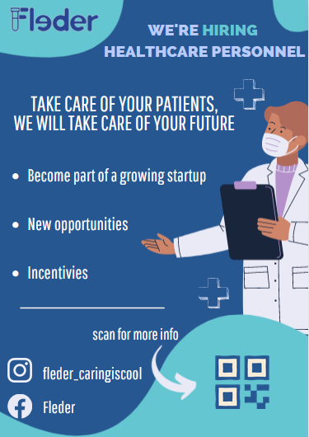
FLYERS MOCKUP

Slide 22

MOCKUP
Decliners are less price conscious
Perceive flyers less useful
Inclined in use other media for deal searching
THE DATA BEHIND THE FLYER
REVIEWING THE STUDY
+
CONSIDERING ENVIRONMENTAL
SUSTAINABILITY
Focus on the quality (rather than quantity)
Includes digital references

Slide 23
2.4
AUTOMATIC
MANAGEMENT
Lack of automatic management
of corporate resources

Slide 24



THE BASE OF THE PROBLEM
Exponential growth of the revenue generated by the app
1
01
More time and money to improve the app and its popularity
02
2
03
Been able to increase both supply and demand
3
04
4
Automatic management of resources

Slide 25




SYSTEM USE CASE
book analyses
date time and address
kit to prepare
analysis to be performed
kit delivery
execution of requested analyses

Slide 26


VALUE POINTS
Smart schedule of work to medical staff
1
Optimized path to follow for medical staff
2
Kit preparation with everything needed for the day's work
3
Smart management of the warehouse
4

Slide 27



IMPLEMENTATION
Server to buy or rent
Development of apps
Managment software creation
VARIANTS
Based on implementation choices of the system, the cost will be different
Several methods to make the implementation cheaper

Slide 28
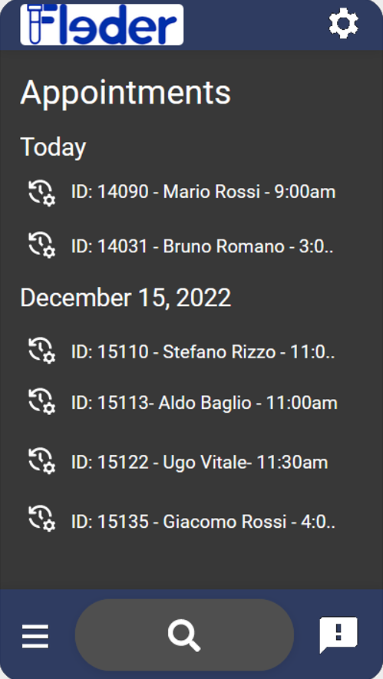
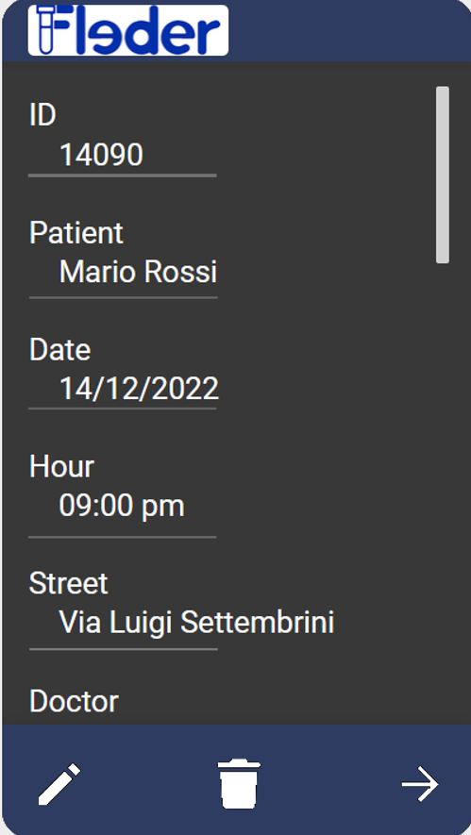
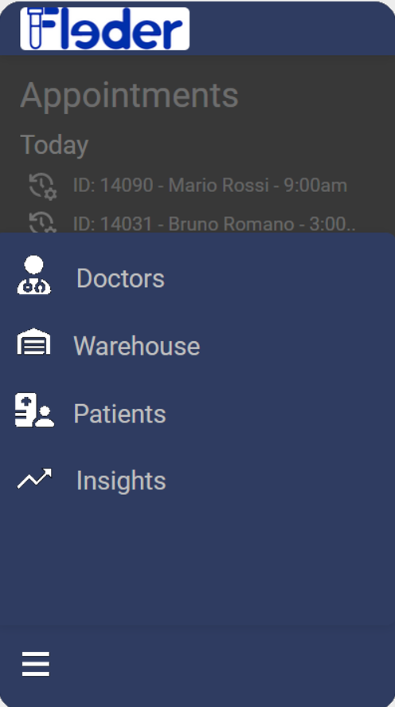
APP
MOCKUP

Slide 29
DETAILS PAGE
HOME PAGE
List of all information related to a single reservation
list of reservations
(sorted chronologically)
edit delete
navigation bar
messages/alerts

Slide 30
MANAGEMENT PAGE
Manage and edit the information related to each field:
Doctors
Warehouse
Patients
Insights
Keeps track of the
Operating and Marketing KPIs
PCR
PCA
MPV
NPS
NFS

Slide 31
2.4
COLLECTING
FEEDBACKS
A small amount of users leaves a feedback of the app

Slide 32
Feedback are very important for an app,
because they serve both as an insurance for customers and as a tool for developers
WHY?
INSURANCE
TOOL
New customers will trust the app and use it, if it has lots of positive review
Useful to understand the strength points of the app that need to be exploit during marketing , and the weak points that need to be reviewed in the future

Slide 33
WELL KNOWN SOLUTIONS
Combine a feedback request with product updates and announcements
Collect live chat data
Text customers immediately after service
Read customers comments on social media
Provide incentives for survey partecipation.
Running polls

Slide 34
03
KPIs & GREEN
APPROACH
Key metrics and a look to the environment impact

Slide 35




WHY ARE KPIs IMPORTANT?
MONITOR
MEASURE
… the company health
… the progress of the projects
ANALYZE
MAKE ADJUSTMENT
… and find patterns over time
… to existing projects and stay on track

Slide 36
KPIs FOUND
Fleder’s KPI | Description
MRR | Monthly Recurring Revenue
ARR | Annual Recurring Revenue
ARA | Average Revenue per Account
MAU | Monthly Active Users
CRR | Customer Retention Rate
NPS | Net Promoter Score
NFS | Net Flyer Score
PCR | Patient Coverage Rate
RCR | Reservation Coverage Rate
PCA | Path Calculation Accuracy
MPV | Monthly Performance Variance

Slide 37





A LOOK TO THE ENVIRONMENT
MOPED
OPTIMIZATION
ECO-FLYERS
Help them dodge the traffic of big cities and pollute less
Help them make more services in a day and pollute less
Help them with advertising and minimize the environment impact

Slide 38
04
CONCLUSION
& NEXT STEPS
Recap and customer feedback

Slide 39
TEAM WORKING STRATEGY
1
Individual Skills
2
Mutual Trust
3
Constant Feedback
4
Cohesion

Slide 40



OUR APPROACH TO THE PROBLEM
DATA DRIVEN
SOLUTION
CORPORATE
VISION
REAL VALUE
PROJECT
We used our skills as data-scientist to approach the problem in an analitic way
Since we worked with a startup we tried to give a shape and a direction, focusing on future goals
The customer has been so happy to partecipate at this project and appreciated the work done!

Slide 41

THANKS
Questions?

